Slide 2
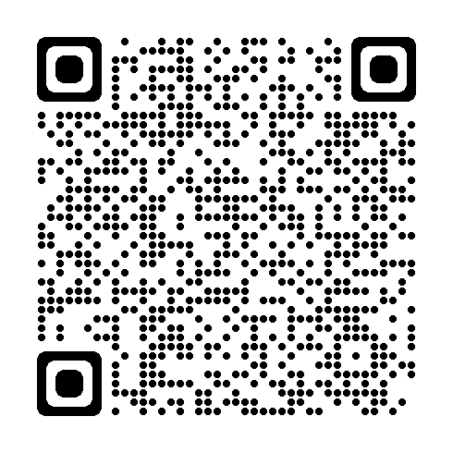
Monthly Learning August 2024
View the full schedule here
August 27 - Ergonomics: Basic principles – Independence
IN-PERSON CLASSES and VIRTUAL TRAINING CLASSES (VTC) qualify for Safety Council rebate external training credits.
Notes:
Provided by Library/Email and also found on BWC Web.

Slide 3
virtual training/Webinars July/August 2024
Virtual training
August 20 - Emergency preparedness planning half-day workshop
August 29 - Work zone traffic control and safety
September 24 - Confined space: Identification and safe practices workshop
Webinars
August 6 - Accident investigation: Ergonomic injuries
September 10- It takes more than a hardhat to keep a head
September 18 - Pitfalls of sedentary work
IN-PERSON CLASSES and VIRTUAL TRAINING CLASSES (VTC) qualify for Safety Council rebate external training credits.

Slide 4
Employer Deadline Dates
Private employer deadlines
Public employer deadlines
August 15 – Policy year 2023 payroll true-up report and payment deadline August 30 – Drug-Free Safety Program action plan (DFSP-5) deadline, Advanced level only, for 7/1 start date
August – No Public Employer deadline dates
Notes:
This slide is hidden but included just to show how the data appeared on one slide.

Slide 5
Emergency Action Plans
Perform a hazard analysis
Create and document your plan
Written procedures with responsibilities​
Established reporting of emergencies​
Identify escape routes​
Roll call/designated meeting location
Rescue and medical duties​
Contact information ​
Provide training
Provide specific PPE
Conduct regular exercises
Notes:
Below are the steps to creating the plan.
Preform a hazard analysis of your facility.
Create and document your plan.
* Written procedures with responsibilities (we have a sample program on BWC Web)
*Establish how to report emergencies.
*What are your escape routes? Create a diagram of the facility for evacuation or escape routes.
*Locate primary outside location, secondary outside location, off-site location and procedures for accounting for all employees.
*Ensure you conduct a roll call to account for all your staff
*Medical Duties: Certified first-aid responders give basic first aid (within their capabilities) during emergency situations. Notify local Emergency Medical Services for events beyond basic first aid.
*Contact Inf: Who is designated as the contact for more information about the plan or explanation of their duties.
All employees should be trained and ensure this training is conducted upon hire​, when the plan changes, when the building exits routs change, continue to review annually.
Provide specific PPE.
Conduct regular exercises.

Slide 6
Emergency Action Plans- Are you prepared?
Emergencies can happen at any time!
Be prepared.
Documenting your plan can mitigate impact.
Identify persons responsible for communications.​
Emergencies are not limited to fire, tornado, violence, flood, medical. ​
Involve a safety team in planning and developing critical operations activities.​
Practice: Tabletop drills and live drills.​
Notes:
Summary comments……
Preparing before an emergency or unexpected event can play a vital role in ensuring your employees have the necessary tools to know how to handle an emergency, know where to go and what is expected to keep everyone safe.
You may consider utilizing the BWC Sample Written Safety Program for Emergency Action Plan (EAP)
Document your plan​ and provide the training to your employees on how to implement this plan. These emergencies can place employees in hazardous positions and need to know what steps are needed to remain safe.
Identify persons responsible for communications. What are the procedures for reporting of the emergency.
Please know emergencies are not limited to fire, tornado, violence, flood and medical emergencies.
Provide specific PPE​ if necessary and don’t forget to conduct regular exercises. Involve your safety team in planning and developing critical operation activities.
Don’t forget to practice. If an emergency occurs, you and your employees know what steps to take.

Slide 7
Emergency Action Plan Resources
BWC: Written safety program templates | Bureau of Workers' Compensation (ohio.gov)​
BWC: Disaster and pandemic preparedness | Bureau of Workers' Compensation (ohio.gov)
OSHA: Emergency Preparedness and Response | Occupational Safety and Health Administration (osha.gov)​
FEMA: FEMA.gov
Notes:
Please drive those in attendance to these resources. You may remind them of our BWC resources including Emergency Action Plan Policy Template. This is our call to action to utilize our services.
BWC Web includes additional resources for emergency action plans and business continuance planning resources. Also, BWC has written safety program templates you may adopt and utilize at your business.
BWC web has:
1. Sample written emergency action program template
2. Emergency action plan emergency contact notification template
3. Evacuation template for show as example
4. Training attendance sign in sheet.

